Slide 1


Models for Regression and Classification
This presentation introduces fundamental concepts in regression and classification. Learn how these models work and how to apply them to real-world problems. Understanding these concepts is crucial for solving machine learning problems.
by precious darkwa

Slide 2

Understanding Supervised Learning
Supervised learning uses labeled data to predict outcomes. The model learns from historical data to map inputs to outputs. This allows classification of new, unseen data based on learned patterns.
Predictive Modeling
Labeled Data
Develop models using historical data to map input variables to output variables
Used to predict or classify new, unseen data based on learned patterns
Common Tasks
Examples include image classification, sentiment analysis, and predictive modeling

Slide 3

Regression Models Explained
Regression models predict continuous output variables like amounts or sizes. This is crucial for estimating numerical outcomes such as sales or prices. Common applications include predicting stock market trends and weather patterns.
House Price Prediction
Stock Market Trend Forecasting
Sales Volume Prediction

Slide 4
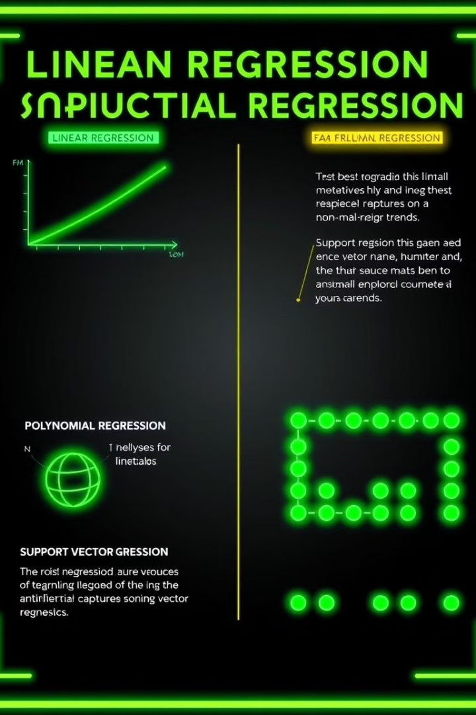



Regression Techniques
Different techniques are used to improve regression results. Linear Regression models relationships as a straight line. Polynomial Regression captures non-linear relationships.
Linear Regression
Polynomial Regression
Support Vector Regression
Models relationship as a straight line
Captures non-linear relationships
Fits best line within a tolerance

Slide 5

Understanding Classification
Classification models categorize data into predefined labels. They classify examples into two or more classes. These models are ideal for categorizing data points.
1
Discrete Labels
Output variables as labels or categories
2
Categorization
Ideal for categorizing data points
3
Multiple Classes
Classifying examples into two or more classes

Slide 6
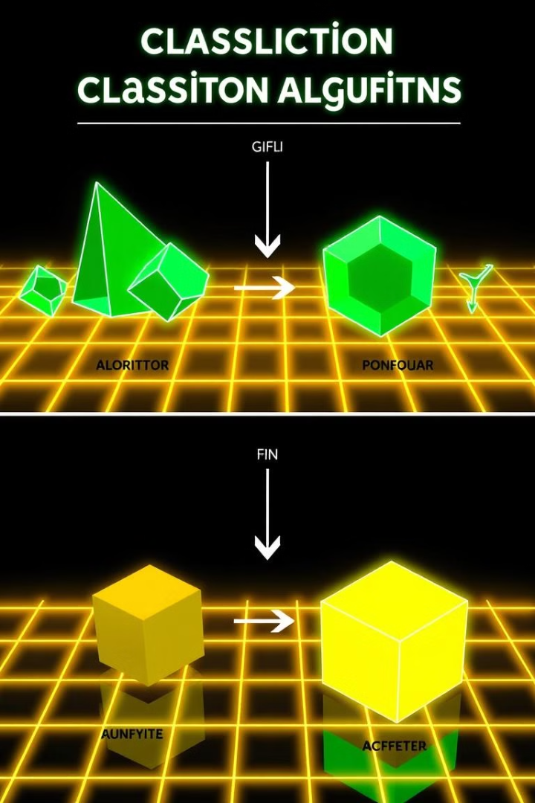



Classification Techniques
Various algorithms are used in classification. Logistic Regression is often used for binary classification. Decision Trees split data into branches.
Logistic Regression
Binary classification
Decision Trees
Splits data into branches
k-NN
k-Nearest Neighbors

Slide 7
Performance Evaluation
Regression Metrics
Classification Metrics
Mean Squared Error (MSE)
Accuracy
Root Mean Squared Error (RMSE)
Precision
R-squared
Recall
F1-score
Evaluate performance using specific metrics. Regression uses MSE and R-squared. Classification uses accuracy and F1-score.

Slide 8


Key Differences
Classification predicts labels. Regression predicts quantities. Regression determines continuous values. Classification forecasts distinct values.
Labels
1
Classification
Quantities
2
Regression

Slide 9
Real-world Applications
Email spam filters use classification models. The model learns to recognize spam features. It classifies incoming emails as spam or not spam.
1
Collect data
2
Label data
3
Train model

Slide 10



Conclusion
Regression and classification are critical tools. Understanding these helps in model selection. Deploy optimal solutions for market problems.
2
Select
1
Understand
Deploy
3

